Slide 1
EECS 498 System Design of a Search Engine
Winter 2026
Lecture 23: Time value of money
Nicole Hamilton
https://web.eecs.umich.edu/~nham/
nham@umich.edu

Slide 2
agenda
details
time value of money

Slide 3
agenda
details
time value of money

Slide 4
details
I have posted guidance on your presentations to Canvas in the Files > Assignments folder.
I have several mixed teams. Please verify I know what section your team is in for scheduling your presentation.
I am working on guidance for your final reports.
Course evals have opened and stay open until Wed Apr 22.
Peer eval forms posted to Canvas, due Tue Apr 21.

Slide 5
remaining schedule
Today: Time value of money
Thu April 9: Reflections on the course
Tue April 14: Review for the final
Thu April 17, Fri April 18, Tue April 21: Presentations
Tues Apr 21: Peer evals, final reports and project archive due
Wed April 22 through Wed April 29: Team debriefs
Wed April 29 4:00pm: Optional final exam

Slide 6
agenda
details
time value of money

Slide 7
time value of money
I first encountered this my last year at Stanford as “Engineering Economy”.
As a skill, I’ve found it to be right up there with typing.

Slide 8
we’ll answer questions like this
Ed McMahon has risen from the dead and is standing on your doorstep, offering you a check for $1,000,000 now or $10,000/month for 20 years. Tax-free.
Which is the better deal?

Slide 9
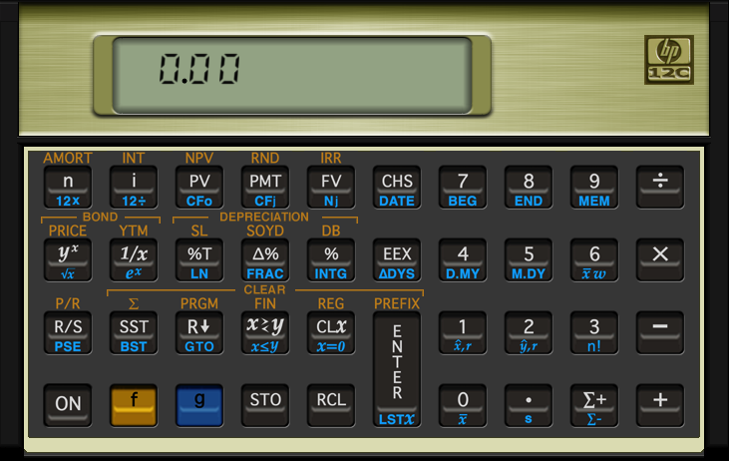
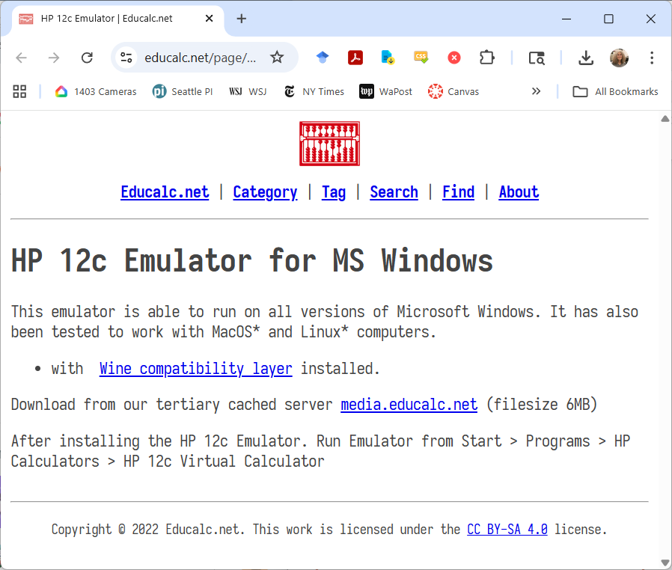
you’ll need an HP-12 emulator
Fortunately, HP released a free one. https://www.educalc.net/page/2338917/
I also have a few physical HP-12s.

Slide 10
A dollar today is worth more than a dollar promised tomorrow.
We discount the future.

Slide 11
terminology
Interest is money paid for the use of borrowed money.
Principal is the amount borrowed.
Interest rate is the interest payable at the end of a period divided by the money owed at the beginning of a period. Usually expressed as a %.

Slide 12
compounding
Simple interest is calculated by multiplying the interest rate x principal x number of periods.
Compound interest is interest added to the principal at the end of each period so that it also earns interest.

Slide 13
example
You borrow $1000 at 6%/year for two years.
How much do you owe at the end?
Simple interest:
$1000 * (1 + .06 * 2) = $1120
Compound interest:
1st year: $1000 * ( 1 + .06) = $1060
2nd year: $1060 * (1 + .06) = $1123 ← An extra $3

Slide 14
$1 invested at 7% doubles every 10 years.

Slide 15
the power of compounding
Manhattan was supposedly purchased by European explorers for $24 in 1626.
If that $24 had been continuously invested at 7%, it would now be worth $6.04 x 10¹² = $6.04 trillion.
The actual estimated current value of Manhattan is about $3 trillion.

Slide 16
reality check
All loans you will ever encounter will always use compound interest.
They will state it as an APR.

Slide 17
APR
Annual Percentage Rate. A term introduced by the Truth in Lending Act of 1968 which standardized disclosure of lending costs.
This is the interest rate for a loan expressed as an annual rate. This is the nominal rate.
But the compounding period is usually monthly meaning the effective interest rate is higher.

Slide 18

converting nominal to effective

Slide 19
Examples

Slide 20
concept of equivalence
Payments that differ in magnitude but are made at different dates may be financially equivalent when discounted at an interest rate.

Slide 21
example
You borrow $10,000 for 10 years at 6% compounded annually.
Any number of repayment schedules might be equivalent.
To examine them, we use cash flow diagrams.

Slide 22
interest only + balloon at the end
$10,000
Borrowed
Year
1 2 3 4 5 6 7 8 9 10
$600/Year
$10,600
Source: Grant & Ireson, Principles of Engineering Economy, 5th Ed., pg. 28.

Slide 23
fixed principal + interest
$10,000
Borrowed
Year
1 2 3 4 5 6 7 8 9 10
$1600
$1540
$1480
$1420
$1360
$1300
$1240
$1180
$1120
$1060

Slide 24
single payment
$10,000
Borrowed
Year
1 2 3 4 5 6 7 8 9 10
$17,908.49

Slide 25
an annuity
$10,000
Borrowed
Year
1 2 3 4 5 6 7 8 9 10
$1358.68/Year
A series of equal payments at the end of each period is called an annuity.

Slide 26
terms
Present value is the value today of any series of discounted payments.
Future value is the value at some future date of any series of discounted payments.

Slide 27
P = Present value
F = Future value
A = Annuity amount at each period
n = Number of periods
i = Interest rate per period

Slide 28
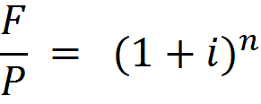
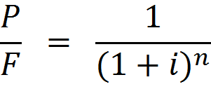
present and future

Slide 29

$10,000
Borrowed
Year
1 2 3 4 5 6 7 8 9 10
$17,908.49

Slide 30
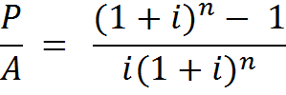
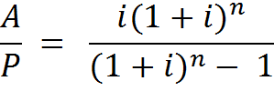


annuities

Slide 31

$10,000
Borrowed
Year
1 2 3 4 5 6 7 8 9 10
$1358.68/Year

Slide 32
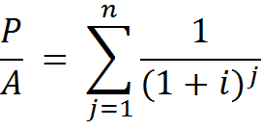
derivation of P/A
$10,000
Borrowed
Year
1 2 3 4 5 6 7 8 9 10
$1358.68/Year
The present value of an annuity is the sum of the present values of the individual payments.
This is a power series.

Slide 33
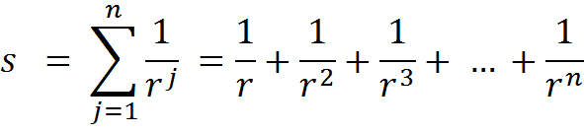



power series

Slide 34
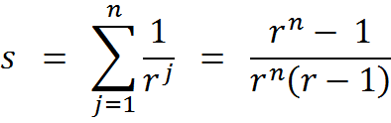



The present value of an annuity is the sum of the present values of the individual payments.
Use the power series rule.
Therefore,

Slide 35
calculating i and n
Given a conversion factor,
Easy to calculate n if you know i.
Easy to calculate i if you know n and F/P or P/F but not so easy for annuities.

Slide 36
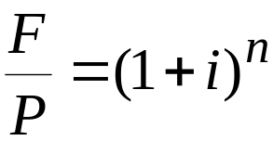
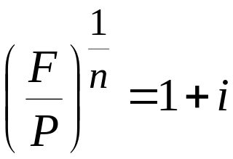
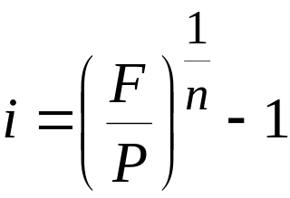
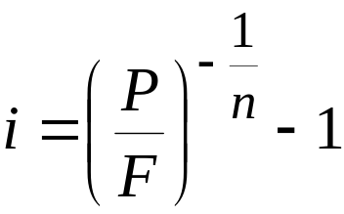
calculating i
Easy enough from F/P:
And because P/F is just the inverse of F/P:

Slide 37
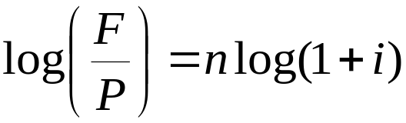
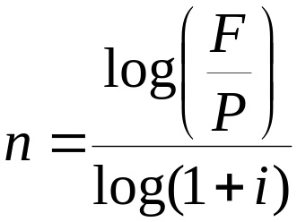
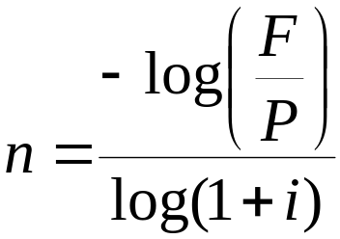
calculating n
Easy enough from F/P:
And because P/F is just the inverse of F/P:

Slide 38
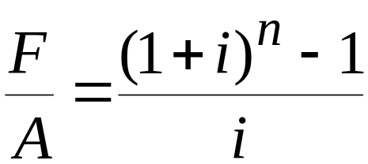
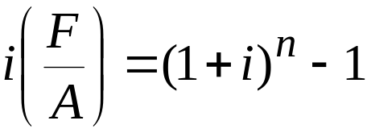
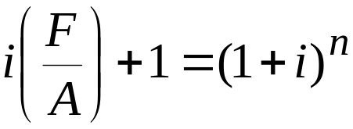
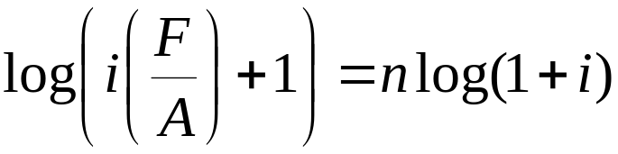
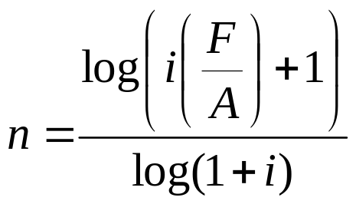
calculating n
And from F/A:

Slide 39
No simple algebraic way to solve for i for an annuity, given F/A and n.
Usual approach is to solve numerically using an iterative approach of making closer and closer estimates.

Slide 40
the workhorse HP-12c

Slide 41
reverse Polish
Stack registers
 |  | x |  |  |  | Last x
 |  | y
 |  | t
 |  | z
x is always displayed.
Whatever you type is in the x register.
Last value of x always kept in Last x.
Operations:
Push ENTER
Rotate R↓
Exchange x↔y
Arithmetic ÷ ─ × +
You enter the operands into the stack, then operate on the top elements.
Instead of 5 + 2 =
you type 5 ENTER 2 +

Slide 42
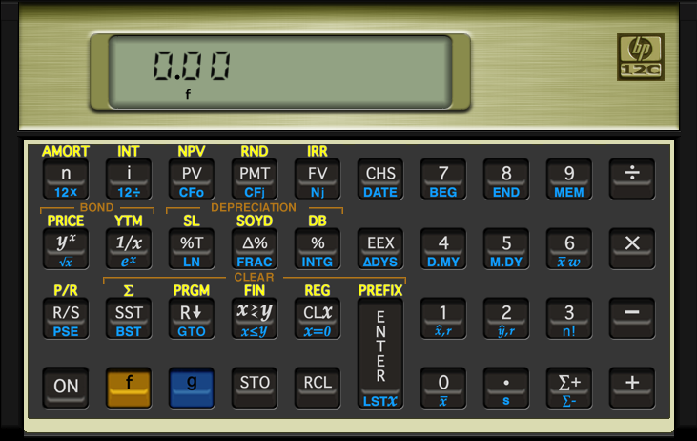
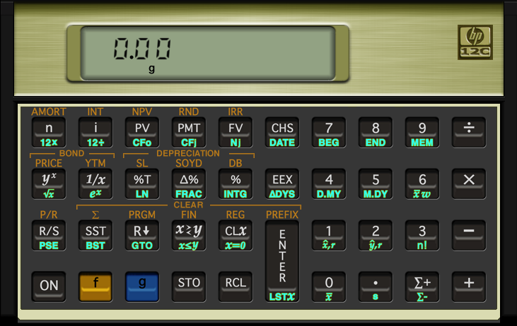
shift keys
f + 0 thru 9 sets number of decimal places.
f + . sets scientific notation.
(Unfortunately, they don’t light up on the real thing.)

Slide 43
clearing registers
f + FIN clears the financial registers.
f + REG clears the stack, Last x and the financial registers.

Slide 44
entering numbers
EEX allows you to type scientific notation.
CHS changes the sign of an exponent or of a number already typed.
To get this Type this
-5 5 CHS
2E6 2 EEX 6
-7E-3 7 CHS EEX 3 CHS

Slide 45
financial registers
Financial registers
 |  | n |  |  |  | N0 |  |  |  | CF0 (R0)
 |  | i |  |  |  | N1 |  |  |  | CF1 (R1)
 |  | PV |  |  |  | N2 |  |  |  | CF2 (R2)
 |  | PMT |  |  |  | N3 |  |  |  | CF3 (R3)
 |  | FV |  |  |  | N4 |  |  |  | CF4 (R4)
 |  |  |  | : |  |  |  | :
 |  |  |  |  |  | N20 |  |  |  | CF20 (R.9)
n = number of periods
i = interest rate as a %
PV = present value
PMT = annuity amount
FV = future value
N1 thru N20 and CF0 thru CF20 are for irregular cash flows, where CFi is repeated Ni times.

Slide 46
financial registers
Financial registers
 |  | n |  |  |  | N0 |  |  |  | CF0 (R0)
 |  | i |  |  |  | N1 |  |  |  | CF1 (R1)
 |  | PV |  |  |  | N2 |  |  |  | CF2 (R2)
 |  | PMT |  |  |  | N3 |  |  |  | CF3 (R3)
 |  | FV |  |  |  | N4 |  |  |  | CF4 (R4)
 |  |  |  | : |  |  |  | :
 |  |  |  |  |  | N20 |  |  |  | CF20 (R.9)
Typing a number and pressing n, i, PV, PMT or FV stores that value.
Pressing n, i, PV, PMT or FV alone calculates the value based on what’s in the other registers.

Slide 47
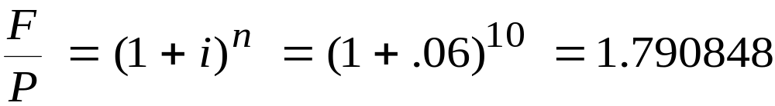
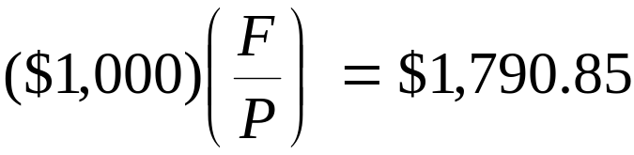
example: $1000 borrowed for 10 years at 6% per year, compounded annually.
$1,000
Borrowed
Year
1 2 3 4 5 6 7 8 9 10
?

Slide 48
example: $1000 borrowed for 10 years at 6% per year.
Financial registers
10 |  | n |  |  |  | N0 |  |  |  | CF0 (R0)
6 |  | i |  |  |  | N1 |  |  |  | CF1 (R1)
1000 |  | PV |  |  |  | N2 |  |  |  | CF2 (R2)
0 |  | PMT |  |  |  | N3 |  |  |  | CF3 (R3)
? |  | FV |  |  |  | N4 |  |  |  | CF4 (R4)
 |  |  |  | : |  |  |  | :
 |  |  |  |  |  | N20 |  |  |  | CF20 (R.9)
$1,000
Borrowed
Year
1 2 3 4 5 6 7 8 9 10
Procedure:
Clear the registers.
Enter n, i and PV.
Press FV.
The result from the formula was $1,790.85.
What does the HP-12c say?
?

Slide 49
But interest rates on loans in the US are stated as APRs.

Slide 50
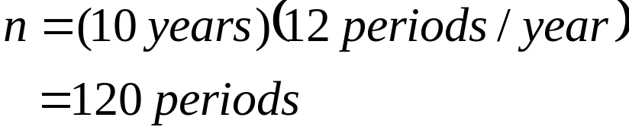
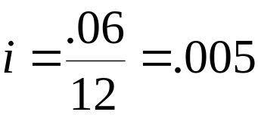
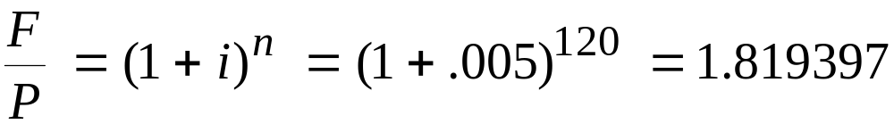
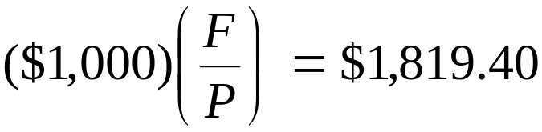
example: $1000 borrowed for 10 years at 6% APR
$1,000
Borrowed
Year
1 2 3 4 5 6 7 8 9 10
?

Slide 51
example: $1000 borrowed for 10 years at 6% APR.
Financial registers
120 |  | n |  |  |  | N0 |  |  |  | CF0 (R0)
.5 |  | i |  |  |  | N1 |  |  |  | CF1 (R1)
1000 |  | PV |  |  |  | N2 |  |  |  | CF2 (R2)
0 |  | PMT |  |  |  | N3 |  |  |  | CF3 (R3)
? |  | FV |  |  |  | N4 |  |  |  | CF4 (R4)
 |  |  |  | : |  |  |  | :
 |  |  |  |  |  | N20 |  |  |  | CF20 (R.9)
$1,000
Borrowed
Year
1 2 3 4 5 6 7 8 9 10
Procedure:
Clear the registers.
Enter n and i using the 12x and 12÷ functions.
Enter PV.
Press FV.
The result from the formula was $1,819.40.
What does the HP-12c say?
?

Slide 52
And most loans in the US require monthly payments.

Slide 53


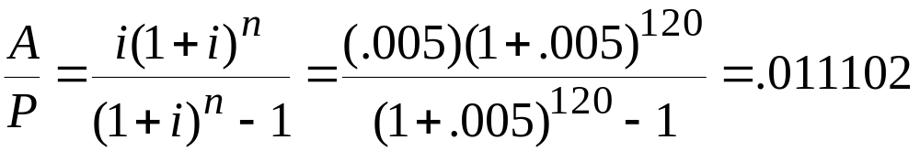
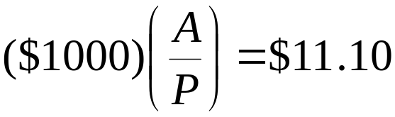
example: $1000 borrowed for 10 years at 6% APR with monthly payments
$1,000
Borrowed
Month
1 2 3 4 5 6 7 … 120
Monthly payment?

Slide 54
example: $1000 borrowed for 10 years at 6% APR with monthly payments.
Financial registers
120 |  | n |  |  |  | N0 |  |  |  | CF0 (R0)
.5 |  | i |  |  |  | N1 |  |  |  | CF1 (R1)
1000 |  | PV |  |  |  | N2 |  |  |  | CF2 (R2)
? |  | PMT |  |  |  | N3 |  |  |  | CF3 (R3)
0 |  | FV |  |  |  | N4 |  |  |  | CF4 (R4)
 |  |  |  | : |  |  |  | :
 |  |  |  |  |  | N20 |  |  |  | CF20 (R.9)
$1,000
Borrowed
Month
1 2 3 4 5 6 7 … 120
Procedure:
Clear the registers.
Enter n and i using the 12x and 12÷ functions.
Enter PV.
Press PMT.
Monthly payment?
The result from the formula was $11.10.
What does the HP-12c say?

Slide 55
example: $1000 borrowed for 10 years with monthly payments of $12. What’s the APR?
Financial registers
120 |  | n |  |  |  | N0 |  |  |  | CF0 (R0)
? |  | i |  |  |  | N1 |  |  |  | CF1 (R1)
1000 |  | PV |  |  |  | N2 |  |  |  | CF2 (R2)
-12 |  | PMT |  |  |  | N3 |  |  |  | CF3 (R3)
0 |  | FV |  |  |  | N4 |  |  |  | CF4 (R4)
 |  |  |  | : |  |  |  | :
 |  |  |  |  |  | N20 |  |  |  | CF20 (R.9)
$1,000
Borrowed
Month
1 2 3 4 5 6 7 … 120
Procedure:
Clear the registers.
Enter n using the 12x function.
Enter PV and PMT
Press i.
Multiply times 12.
Monthly payment = $12

Slide 56
exercise
You owe $1000 at 29.99% APR. If you make no payments, what will you owe a year from now?

Slide 57
$1000 borrowed for 1 year at 29.99% APR
Financial registers
12 |  | n |  |  |  | N0 |  |  |  | CF0 (R0)
2.4992 |  | i |  |  |  | N1 |  |  |  | CF1 (R1)
1000 |  | PV |  |  |  | N2 |  |  |  | CF2 (R2)
0 |  | PMT |  |  |  | N3 |  |  |  | CF3 (R3)
? |  | FV |  |  |  | N4 |  |  |  | CF4 (R4)
 |  |  |  | : |  |  |  | :
 |  |  |  |  |  | N20 |  |  |  | CF20 (R.9)
$1,000
Borrowed
Month
1 2 3 4 5 6 7 8 9 10 11 12
Procedure:
Clear the registers.
Enter n and i using the 12x and 12÷ functions.
Enter PV.
Press FV.
?

Slide 58
exercise
Ten years ago, Acme Corporation financed a new warehouse in part with a mortgage for $500K for 20 years at 5%.
What’s their monthly mortgage payment?

Slide 59
exercise
Ten years ago, Acme Corporation financed a new warehouse in part with a mortgage for $500K for 20 years at 5%.
What’s their monthly mortgage payment?
Hint: Interest rates on loans in the US are stated as APRs.

Slide 60
$500K borrowed for 20 years at 5% APR with monthly payments.
Financial registers
240 |  | n |  |  |  | N0 |  |  |  | CF0 (R0)
.41667 |  | i |  |  |  | N1 |  |  |  | CF1 (R1)
500000 |  | PV |  |  |  | N2 |  |  |  | CF2 (R2)
? |  | PMT |  |  |  | N3 |  |  |  | CF3 (R3)
0 |  | FV |  |  |  | N4 |  |  |  | CF4 (R4)
 |  |  |  | : |  |  |  | :
 |  |  |  |  |  | N20 |  |  |  | CF20 (R.9)
$500K
Borrowed
Month
1 2 3 4 5 6 7 … 240
Procedure:
Clear the registers.
Enter n and i using the 12x and 12÷ functions.
Enter PV.
Press PMT.
Monthly payment?
Should be $3,299.78/month.

Slide 61
exercise
Acme has just made their 120th payment on the mortgage. What is the remaining principal on the loan?

Slide 62
exercise
Acme has just made their 120th payment on the mortgage. What is the remaining principal on the loan?
Hint: Acme has 10 years = 120 payments left and the interest rate is unchanged.

Slide 63
principal remaining after 120th payment
Financial registers
120 |  | n |  |  |  | N0 |  |  |  | CF0 (R0)
.41667 |  | i |  |  |  | N1 |  |  |  | CF1 (R1)
? |  | PV |  |  |  | N2 |  |  |  | CF2 (R2)
-3299.78 |  | PMT |  |  |  | N3 |  |  |  | CF3 (R3)
0 |  | FV |  |  |  | N4 |  |  |  | CF4 (R4)
 |  |  |  | : |  |  |  | :
 |  |  |  |  |  | N20 |  |  |  | CF20 (R.9)
Remaining
principal
Month
1 2 3 4 5 6 7 … 120
Procedure:
Clear the registers.
Enter n and i using the 12x and 12÷ functions.
Enter PMT.
Press PV.
Monthly payment = $3,299.78
Remaining principal should be $311,107.59.

Slide 64
exercise
Ten years ago, Acme Corporation financed a new warehouse in part with a mortgage for $500K for 20 years at 5%.
A year from now, Acme will have just made their 132nd payment. Between now and then, how much interest will Acme have paid?

Slide 65
After the 132nd payment, Acme will have 240 – 132 = 108 payments left.

Slide 66
principal remaining after 132nd payment
Financial registers
108 |  | n |  |  |  | N0 |  |  |  | CF0 (R0)
.41667 |  | i |  |  |  | N1 |  |  |  | CF1 (R1)
? |  | PV |  |  |  | N2 |  |  |  | CF2 (R2)
-3299.78 |  | PMT |  |  |  | N3 |  |  |  | CF3 (R3)
0 |  | FV |  |  |  | N4 |  |  |  | CF4 (R4)
 |  |  |  | : |  |  |  | :
 |  |  |  |  |  | N20 |  |  |  | CF20 (R.9)
Remaining
principal
Month
1 2 3 4 5 6 7 … 108
Procedure:
Clear the registers.
Enter n and i using the 12x and 12÷ functions.
Enter PMT.
Press PV.
Monthly payment = $3,299.78
Remaining principal should be $286,506.94.

Slide 67
after 132nd payment
Remaining principal = $286,506.94
Amount of principal paid off in the year =
Remaining principal after 120th payment –
Remaining principal after 132nd payment
= 311,107.59 – 286,506.94 = $24,600.65
Total of payments = 12 * 3299.78 = $39,597.36
Interest paid = Total payments – Principal paid off
= 39,597.36 – 24,600.65 = $14,996.69

Slide 68
amortization

Slide 69
amortize
A term used in lending that means each payment will allocated to separate principal and interest amounts.
The allocation is calculated to the nearest unit, usually a penny.
When the remaining principal goes to zero, the loan is fully amortized.
Most commonly used in mortgage loans.
Typically presented as a table called an amortization schedule.

Slide 70
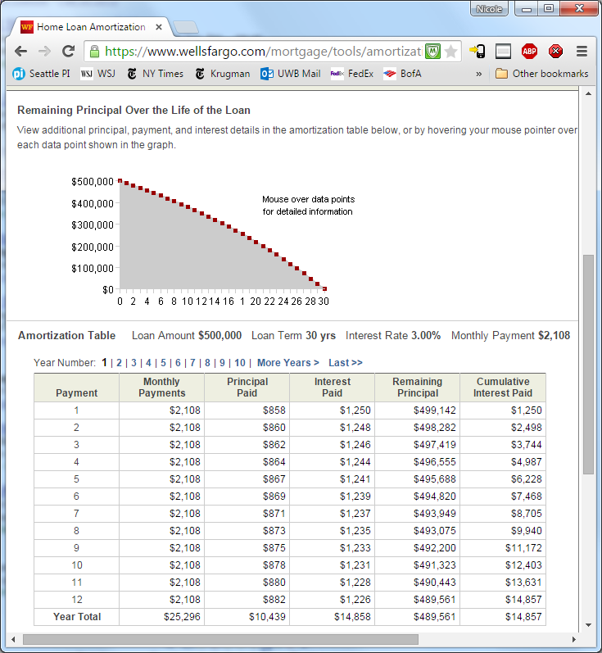
https://www.wellsfargo.com/mortgage/tools/amortization/

Slide 71
amortization function
Financial registers
0 |  | n |  |  |  | N0 |  |  |  | CF0 (R0)
.41667 |  | i |  |  |  | N1 |  |  |  | CF1 (R1)
500000 |  | PV |  |  |  | N2 |  |  |  | CF2 (R2)
-3299.78 |  | PMT |  |  |  | N3 |  |  |  | CF3 (R3)
0 |  | FV |  |  |  | N4 |  |  |  | CF4 (R4)
 |  |  |  | : |  |  |  | :
 |  |  |  |  |  | N20 |  |  |  | CF20 (R.9)
$500K
Borrowed
Month
Procedure:
Clear the registers.
Enter PV, PMT, n and i.
Enter number of payments to amortize.
Press AMORT.
x contains interest paid
y contains principal paid
RCL PV to get principal remaining
RCL n to get number of payments amortized so far.
1 2 3 4 5 6 7 … 240
…
Monthly payment = $3,299.78
How much interest and principal has been paid by the 120th payment?

Slide 72
principal remaining after 120th payment
Slight difference between:
PV of remaining payments = $311,107.59
Amortized remaining principal = $311,107.41
Difference is because under amortization, amounts allocated to principal versus interest are calculated only to the nearest penny (or whatever digits of precision you’ve set via f-key.)
(A bank will care about this difference, I don’t.)

Slide 73
creating an amortization schedule
Because:
Principal paid is subtracted from PV.
Number of payments amortized added to n.
The amortization function can be used to be used to amortize successive payments.
PV always contains remaining principal.
n always contains number of payment amortized so far.
Works with loans that never fully amortize, e.g., because of a balloon payment at the end.

Slide 74
exercise
You’ve just bought a home with $400K, 30-year mortgage at 3% APR.
What does the cash flow diagram look like?
What is your monthly payment?
Fill in this table for the first 3 years:
Year | Beginning principal | Principal paid | Interest paid | Ending principal
1 | 400,000
2
3
Total paid

Slide 75
$400K borrowed for 30 years at 3% APR with monthly payments.
Financial registers
360 |  | n |  |  |  | N0 |  |  |  | CF0 (R0)
.25 |  | i |  |  |  | N1 |  |  |  | CF1 (R1)
400000 |  | PV |  |  |  | N2 |  |  |  | CF2 (R2)
? |  | PMT |  |  |  | N3 |  |  |  | CF3 (R3)
0 |  | FV |  |  |  | N4 |  |  |  | CF4 (R4)
 |  |  |  | : |  |  |  | :
 |  |  |  |  |  | N20 |  |  |  | CF20 (R.9)
$400K
Borrowed
Month
1 2 3 4 5 6 7 … 360
Procedure:
Clear the registers.
Enter n and i using the 12x and 12÷ functions.
Enter PV.
Press PMT.
Monthly payment?
Should be $1,686.42/month.

Slide 76
amortize first year
Financial registers
0 |  | n |  |  |  | N0 |  |  |  | CF0 (R0)
.25 |  | i |  |  |  | N1 |  |  |  | CF1 (R1)
400000 |  | PV |  |  |  | N2 |  |  |  | CF2 (R2)
-1686.42 |  | PMT |  |  |  | N3 |  |  |  | CF3 (R3)
0 |  | FV |  |  |  | N4 |  |  |  | CF4 (R4)
 |  |  |  | : |  |  |  | :
 |  |  |  |  |  | N20 |  |  |  | CF20 (R.9)
$400K
Borrowed
Month
1 2 3 4 5 6 7 … 360
Procedure:
Set n = 0.
Enter 12 payments to amortize.
Press AMORT.
x contains interest paid
y contains principal paid
RCL PV to get principal remaining
…
Monthly payment = $1,686.42
Interest paid = $11,885.80
Principal paid = $8,351.24
Principal remaining = $391,648.76

Slide 77
amortize second year
Financial registers
12 |  | n |  |  |  | N0 |  |  |  | CF0 (R0)
.25 |  | i |  |  |  | N1 |  |  |  | CF1 (R1)
391648.76 |  | PV |  |  |  | N2 |  |  |  | CF2 (R2)
-1686.42 |  | PMT |  |  |  | N3 |  |  |  | CF3 (R3)
0 |  | FV |  |  |  | N4 |  |  |  | CF4 (R4)
 |  |  |  | : |  |  |  | :
 |  |  |  |  |  | N20 |  |  |  | CF20 (R.9)
$400K
Borrowed
Month
1 2 3 4 5 6 7 … 360
Procedure:
Enter 12 payments to amortize.
Press AMORT.
x contains interest paid
y contains principal paid
RCL PV to get principal remaining
…
Monthly payment = $1,686.42
Interest paid = $11,631.78
Principal paid = $8,605.26
Principal remaining = $383,043.50

Slide 78
amortize third year
Financial registers
24 |  | n |  |  |  | N0 |  |  |  | CF0 (R0)
.41667 |  | i |  |  |  | N1 |  |  |  | CF1 (R1)
383043.50 |  | PV |  |  |  | N2 |  |  |  | CF2 (R2)
-1686.42 |  | PMT |  |  |  | N3 |  |  |  | CF3 (R3)
0 |  | FV |  |  |  | N4 |  |  |  | CF4 (R4)
 |  |  |  | : |  |  |  | :
 |  |  |  |  |  | N20 |  |  |  | CF20 (R.9)
$400K
Borrowed
Month
1 2 3 4 5 6 7 … 360
Procedure:
Enter 12 payments to amortize.
Press AMORT.
x contains interest paid
y contains principal paid
RCL PV to get principal remaining
…
Monthly payment = $1,686.42
Interest paid = $11,370.04
Principal paid = $8,867.00
Principal remaining = $374,176.50

Slide 79
exercise
You’ve just bought a home with $400K, 30-year mortgage at 3% APR.
What does the cash flow diagram look like?
What is your monthly payment? $1,686.42
Fill in this table for the first 3 years:
$400K
Borrowed
Month
1 2 3 4 5 6 7 … 360
Monthly payment = $1,686.42
Year | Beginning principal | Principal paid | Interest paid | Ending principal
1 | 400,000 | 8,351.24 | 11,885.80 | 391,648.76
2 | 391,648.76 | 8,605.26 | 11,631.78 | 383,043.50
3 | 383,043.50 | 8,867.00 | 11,370.04 | 374,176.50
Total paid |  | 25,823.50 | 34,887.62

Slide 80
escrow
Usually when you get a mortgage, your payment will be more than principal + interest.
Usually, the bank will want you to escrow fire insurance and property tax payments.
You pay an amount each month estimated to cover insurance and tax.
The mortgage company then makes those payments.
This way, the mortgage company knows for sure that the payments got made.

Slide 81
investments
Interest rates on investments are different than interest rates on loans.
Loans are stated as APRs and are compounded monthly.
Investors normally use annual compounding when evaluating an investment.

Slide 82
sinking funds
Future value
at 10%?
Year
0 1 2 3 4 5 6
7 8 9 10
$2K
Annuities that you pay into to get a future return are call sinking funds.
An example would be a regular savings plan.
Annuity payments are at the beginning of the period, not the end.

Slide 83
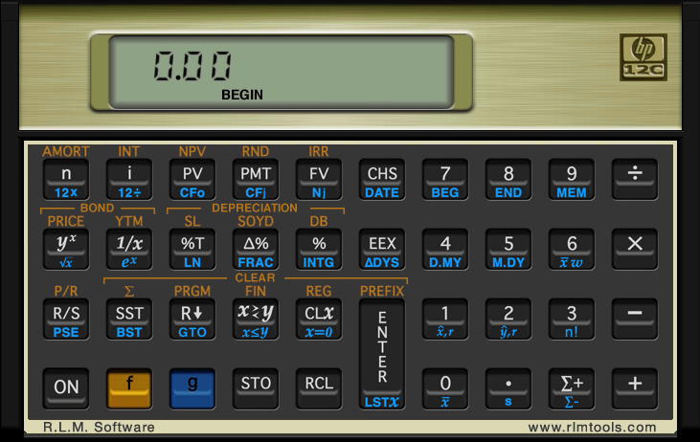
sinking fund at 10%
Financial registers
10 |  | n |  |  |  | N0 |  |  |  | CF0 (R0)
10 |  | i |  |  |  | N1 |  |  |  | CF1 (R1)
0 |  | PV |  |  |  | N2 |  |  |  | CF2 (R2)
-2K |  | PMT |  |  |  | N3 |  |  |  | CF3 (R3)
0 |  | FV |  |  |  | N4 |  |  |  | CF4 (R4)
 |  |  |  | : |  |  |  | :
 |  |  |  |  |  | N20 |  |  |  | CF20 (R.9)
Future value at 10%?
Should be $35,062.33
Procedure:
Clear the registers.
Set in BEGIN mode.
Enter n and i.
Press FV.
Year
0 1 2 3 4 5 6
7 8 9 10
$2K

Slide 84
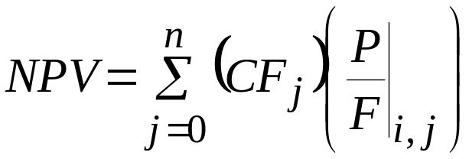
Net present value (NPV)
Net sum of all the discounted inflows and outflows.
Could be either positive or negative.
At the internal rate of return (IRR), the NPV is zero.

Slide 85
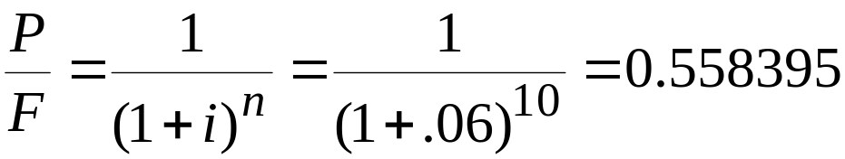
Consider this possible investment.
$17,908.49
Year
0 1 2 3 4 5 6 7 8 9
10
$10K
At 6%
Similarly,
At 5% NPV = $994.26
At 7% NPV = -$896.23

Slide 86
calculating IRR
Calculate NPV at interest rates expected to be above and below the actual IRR, then interpolate.
Use a calculator or a spreadsheet that provides an IRR function.

Slide 87
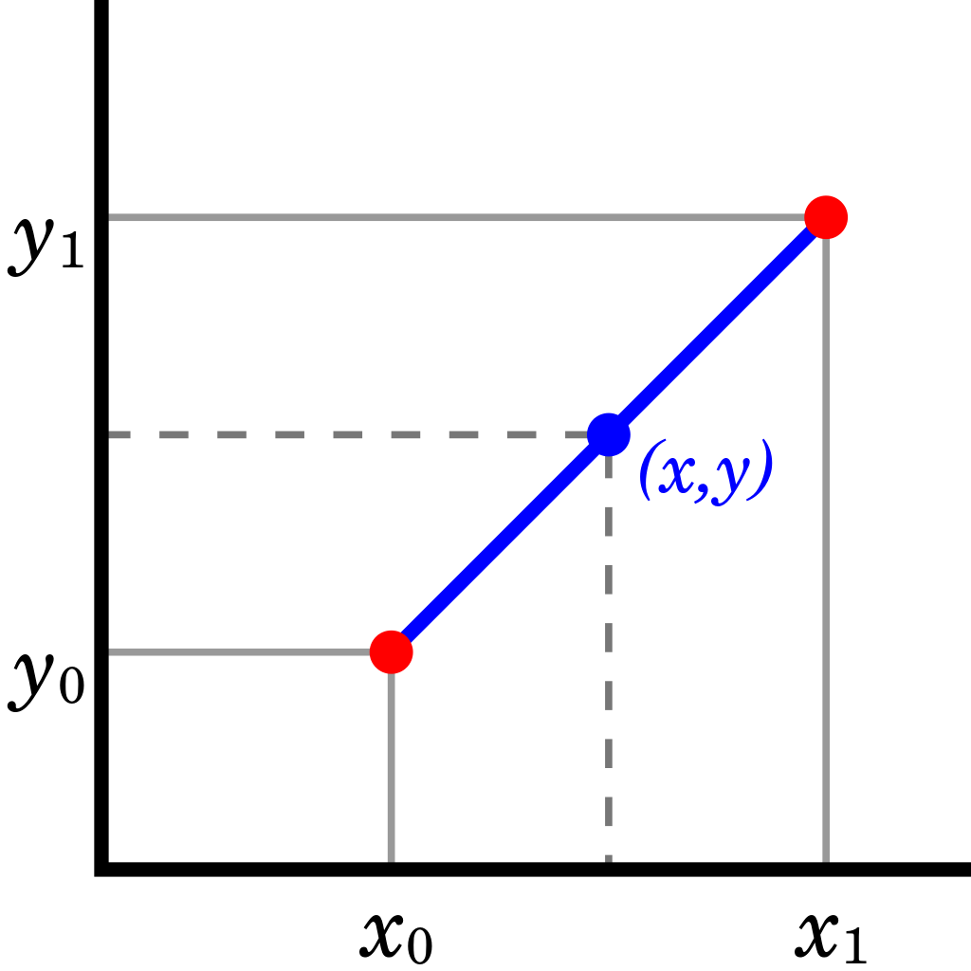
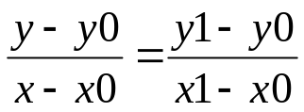
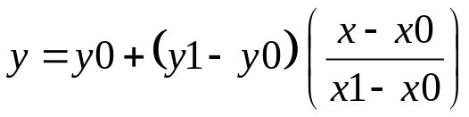
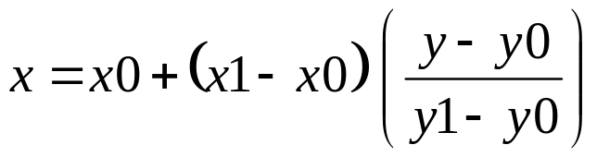
Simple interpolation
Approximating with a straight line
Choose the points on either side of the point you’d like to estimate.
Given the desired x:
Given the desired y:
Image source: https://en.wikipedia.org/wiki/File:LinearInterpolation.svg

Slide 88
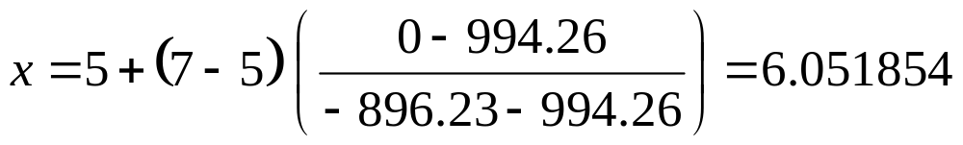
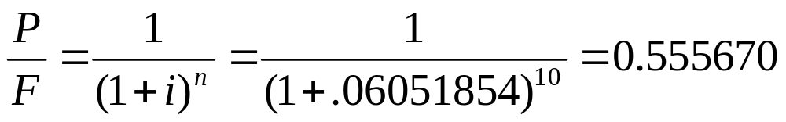
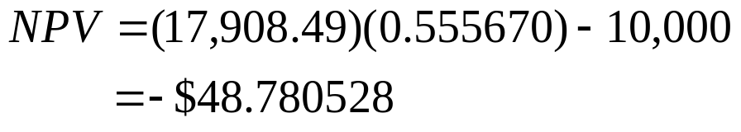
interpolating
x = interest rate
x0 = 5%
x1 = 7%
y = NPV
y0 =994.26
y1 = -896.23
Find the x (interest rate) at which y (NPV) = 0
At 5% NPV = $994.26
At 7% NPV = -$896.23

Slide 89
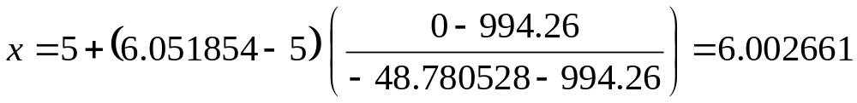
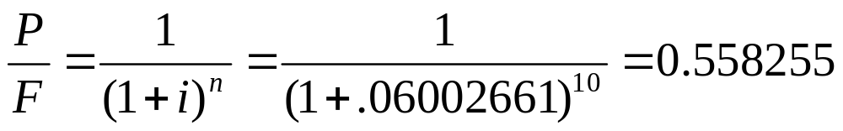
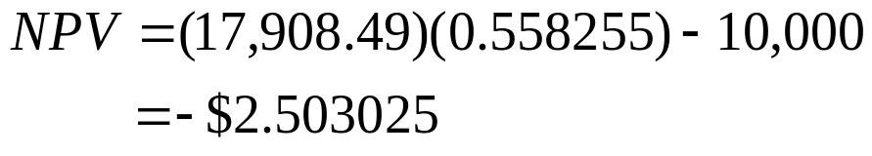
next iteration
x = interest rate
x0 = 5%
x1 = 6.0518954%
y = NPV
y0 =994.26
y1 = -48.780528
Find the x (interest rate) at which y (NPV) = 0
At 5% NPV = $994.26
At 6.051854%
NPV = -$48.780528

Slide 90
hurdle rates
For a consumer, the cost of funds is whatever interest rate they’re paying on debt.
But big corporations will often establish hurdle rates.
A hurdle rate is the minimum expected IRR the corporation expects from projects it will fund.
Hurdle rates are intended to be related to the firm’s cost of capital, overall risk and other factors.
A typical corporate hurdle rate is 12% but could be 30% or higher.

Slide 91
irregular cash flows
When the cash flows in/out aren’t uniform like an annuity, it’s called an irregular cash flow.
$20K
Is this a good deal?
$3K
Year
0 1 2 3 4 5 6
7 8 9 10
$2K
$10K

Slide 92
$20K
j | Cf_{j} | N_{j}
0 | -10,000.00 | 1
1 | -10,000.00 | 1
2 | -2,000.00 | 5
3 | 3,000.00 | 2
4 | 20,000.00 | 2
Is this a good deal?
$3K
Year
0 1 2 3 4 5 6
7 8 9 10
$2K
$10K

Slide 93
IRR for an irregular cash flow.
Financial registers
0 |  | n |  | 1 |  | N0 |  | -10K |  | CF0 (R0)
0 |  | i |  | 1 |  | N1 |  | -10K |  | CF1 (R1)
0 |  | PV |  | 5 |  | N2 |  | -2K |  | CF2 (R2)
0 |  | PMT |  | 2 |  | N3 |  | 3K |  | CF3 (R3)
0 |  | FV |  | 2 |  | N4 |  | 20K |  | CF4 (R4)
 |  |  |  | : |  |  |  | :
 |  |  |  |  |  | N20 |  |  |  | CF20 (R.9)
$20K
Should be IRR = 5.75%.
$3K
Procedure:
Clear the registers.
CF0 = -10,000.
Enter CF1 = -10,000, N1 = 1.
Repeat for CF2 thru CF4.
Press IRR.
Year
0 1 2 3 4 5 6
7 8 9 10
$2K
$10K

Slide 94
NPV for an irregular cash flow at 7%
Financial registers
0 |  | n |  | 1 |  | N0 |  | -10K |  | CF0 (R0)
0 |  | i |  | 1 |  | N1 |  | -10K |  | CF1 (R1)
0 |  | PV |  | 5 |  | N2 |  | -2K |  | CF2 (R2)
0 |  | PMT |  | 2 |  | N3 |  | 3K |  | CF3 (R3)
0 |  | FV |  | 2 |  | N4 |  | 20K |  | CF4 (R4)
 |  |  |  | : |  |  |  | :
 |  |  |  |  |  | N20 |  |  |  | CF20 (R.9)
$20K
Should be NPV = -$2,349.78
Procedure:
Clear the registers.
CF0 = -10,000.
Enter CF1 = -10,000, N1 = 1.
Repeat for CF2 thru CF4.
Enter i = 7%.
Press NPV
$3K
Year
0 1 2 3 4 5 6
7 8 9 10
$2K
$10K

Slide 95
comparing alternatives
Calculate the NPV of each alternative at your discount rate, then choose the one with highest NPV.
Calculate the IRR for each alternative, then choose the one with the highest IRR.
Calculate the NPV of the differences between the two alternatives.

Slide 96
exercise
You need to replace your furnace. You have two options.
For $15K, you can buy a low efficiency unit that will cost you $140/mo in gas.
For $20K, you can buy a high efficiency unit that will cost you $80/mo in gas.
You expect either will have a 10 year lifetime.
Draw the two cash flow diagrams.
You expect to pay for the new furnace with a loan at 8% APR. Which would you choose?

Slide 97
Month
1 2 3 4 5 6 7 8 9 10 119 120
Low
efficiency
…
$15,000
Initial cost
$140 per month for gas
Month
1 2 3 4 5 6 7 8 9 10 119 120
…
High
efficiency
$20,0000
Initial cost
$80 per month for gas

Slide 98
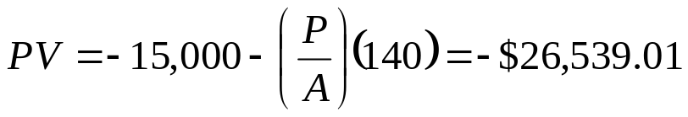
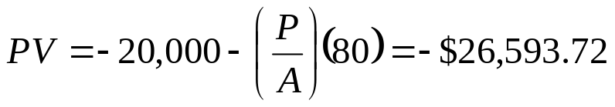
Month
1 2 3 4 5 6 7 8 9 10 119 120
Low
efficiency
…
$15,000
Initial cost
$140 per month for gas
Month
1 2 3 4 5 6 7 8 9 10 119 120
…
High
efficiency
$20,0000
Initial cost
$80 per month for gas

Slide 99
In this completely made-up example, the low efficiency furnace is slightly cheaper:
$26,593.72 – 26,539.07 = $54.72 savings
If the difference was that small, a lot of people would probably choose high efficiency.
  Risk of energy costs rising,
  Resale value
  Social consciousness.

Slide 100
exercise
Ed McMahon has risen from the dead and is standing on your doorstep, offering you a check for $1,000,000 now or $10,000/month for 20 years. Tax-free.
Which is the better deal?

Slide 101
What is the IRR?
$1,000,000
Month
1 2 3 4 5 6 7 8 9 10 239 240
…
$10,000 per month for 20 years

Slide 102
finding IRR
Financial registers
240 |  | n |  |  |  | N0 |  |  |  | CF0 (R0)
 |  | i |  |  |  | N1 |  |  |  | CF1 (R1)
1M |  | PV |  |  |  | N2 |  |  |  | CF2 (R2)
-10K |  | PMT |  |  |  | N3 |  |  |  | CF3 (R3)
0 |  | FV |  |  |  | N4 |  |  |  | CF4 (R4)
 |  |  |  | : |  |  |  | :
 |  |  |  |  |  | N20 |  |  |  | CF20 (R.9)
$1,000,000
Month
Procedure:
Clear the registers.
Set in BEGIN mode.
Enter n = 240.
Enter PV and PMT.
Press i (rate per month)
1 2 3 4 5 6 … 239 240
…
$10,000 per month for 20 years

Slide 103
depends on your discount rate
IRR = 10.66% APR = 11.19% effective
At 8%, the annuity is worth $1,203,513.20
At 12%, the annuity is worth $917,276.11
If you prefer cash now, you’ll choose the $1M.

Slide 104
exercise
You need a car for the next 3 years and you’re considering two alternatives.
1. An older gas guzzler for $5,000 which you estimate will require $150/month for gas and $100/month on repairs. After 3 years, you expect it could be sold for $3,000.
2. A newer, more efficient car that for $12,000 that would need only $80/month in gas and $40/ month for repairs. After 3 years, you expect it could be sold for $6,000.
You’re living on money you’re borrowing at 8% APR. Which is the better deal?

Slide 105
Month
$3,000
1 2 3 4 5 6 7 8 9 10 35 36
Gas
guzzler
…
$5,000
Initial cost
$250 per month for gas + repairs
$6,000
Month
1 2 3 4 5 6 7 8 9 10 35 36
…
Efficient
car
$12,0000
Initial cost
$120 per month for gas + repairs

Slide 106
NPV = -$10,616.19
Month
$3,000
1 2 3 4 5 6 7 8 9 10 35 36
Gas
guzzler
…
$5,000
Initial cost
$250 per month for gas + repairs
$6,000
NPV = -$11,105.89
Month
1 2 3 4 5 6 7 8 9 10 35 36
…
Efficient
car
$12,0000
Initial cost
$120 per month for gas + repairs

Slide 107
exercise
You need to replace your furnace. You have two options.
For $15K, you can buy a low efficiency unit that will cost you $140/mo in gas.
For $20K, you can buy a high efficiency unit that will cost you $80/mo in gas.
You expect either will have a 10 year lifetime.
Draw the two cash flow diagrams.
You expect to pay for the new furnace with a loan at 8% APR. Which would you choose?

Slide 108
Month
1 2 3 4 5 6 7 8 9 10 119 120
Low
efficiency
…
$15,000
Initial cost
$140 per month for gas
Month
1 2 3 4 5 6 7 8 9 10 119 120
…
High
efficiency
$20,0000
Initial cost
$80 per month for gas

Slide 109
Month
1 2 3 4 5 6 7 8 9 10 119 120
Low
efficiency
…
$15,000
Initial cost
$140 per month for gas
Month
1 2 3 4 5 6 7 8 9 10 119 120
…
High
efficiency
$20,0000
Initial cost
$80 per month for gas

Slide 110
In this completely made-up example, the low efficiency furnace is slightly cheaper:
$26,593.72 – 26,539.07 = $54.72 savings
If the difference was that small, a lot of people would probably choose high efficiency.
  Risk of energy costs rising,
  Resale value
  Social consciousness.

Slide 111
exercise
Ed McMahon has risen from the dead and is standing on your doorstep, offering you a check for $1,000,000 now or $10,000/month for 20 years. Tax-free.
Which is the better deal?

Slide 112
what is the IRR?
$1,000,000
Month
1 2 3 4 5 6 7 8 9 10 239 240
…
$10,000 per month for 20 years

Slide 113
finding IRR
Financial registers
240 |  | n |  |  |  | N0 |  |  |  | CF0 (R0)
 |  | i |  |  |  | N1 |  |  |  | CF1 (R1)
1M |  | PV |  |  |  | N2 |  |  |  | CF2 (R2)
-10K |  | PMT |  |  |  | N3 |  |  |  | CF3 (R3)
0 |  | FV |  |  |  | N4 |  |  |  | CF4 (R4)
 |  |  |  | : |  |  |  | :
 |  |  |  |  |  | N20 |  |  |  | CF20 (R.9)
$1,000,000
Month
Procedure:
Clear the registers.
Set in BEGIN mode.
Enter n = 240.
Enter PV and PMT.
Press i (rate per month)
1 2 3 4 5 6 … 239 240
…
$10,000 per month for 20 years

